Slide 1
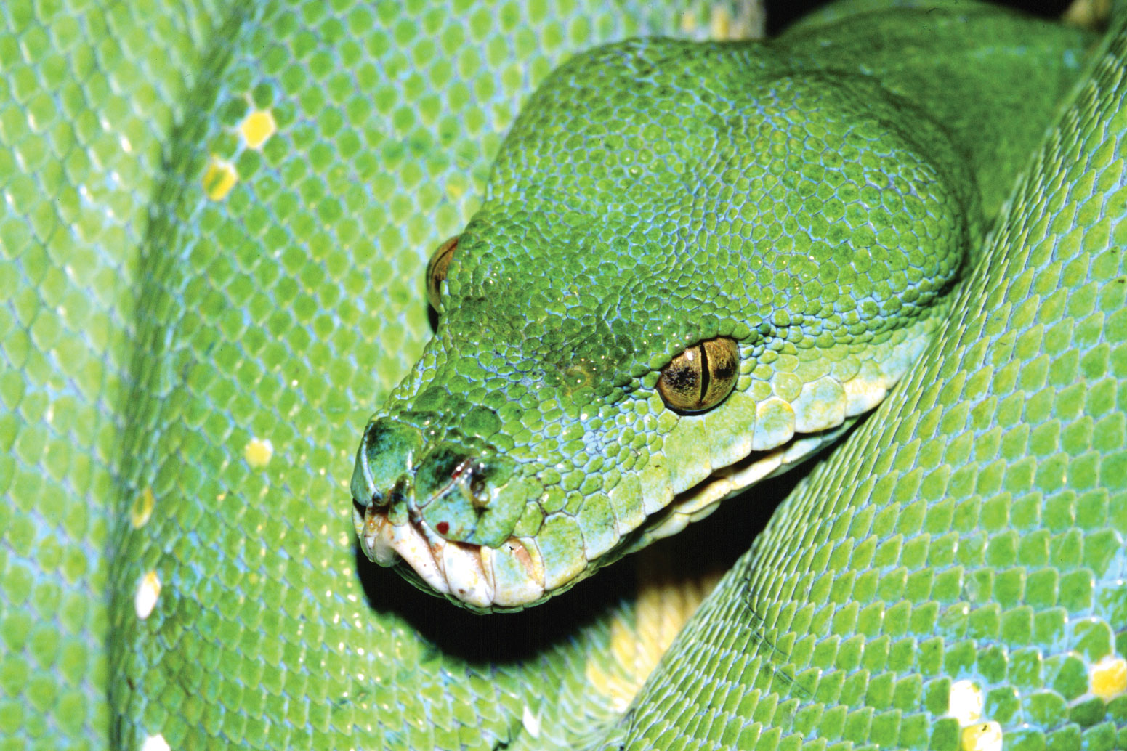
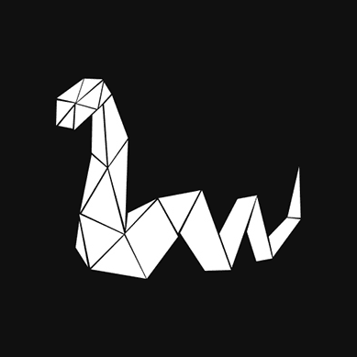
Dive into Scientific Python
Yoav Ram
March 2017
Encyclopædia Britannica Online

Slide 2

Who I am
Yoav Ram @yoavram
Postdoc at Stanford University
PhD in BioMath from Tel-Aviv University
Using Python since 2002
Using & teaching Scientific Python since 2011
Python training for engineers & data scientists
Presentation & source code on GitHub: http://git.io/14032017
License: CC-BY-SA 4.0

Slide 3
Why Python?
for scientific computing…
I used Matlab. Now I use Python. by Steve Tjoa
Why use Python for scientific computing?

Slide 4
Python is Free

Slide 5
Gratis: Free as in Beer
MATLAB is expensive (as of Feb 2017)
Individuals: $2,350
Academia: $550
Personal: $85
Student: $29-55
Batteries (toolboxes…) not included
Python is totally free
Batteries included (NumPy, SciPy…)
R is also free
MathWork Pricing

Slide 6
Libre: Free as in Speech
MATLAB source code is closed and proprietary
You cannot see the code
You cannot change the code
You can participate in the discussion as a client
Python source code is open
You can see, you can change, you can contribute code and documentation (python, numpy)
You can participate in the discussion as a peer (python, numpy)
R is also open

Slide 7
Python is a general-purpose language
R and MATLAB are used primarily for scientific computing

Slide 8
Python is used for:
Scientific computing
Enterprise software
Web design
Back-end
Front-end
Everything in between

Slide 9
Python is used at
Google, Rackspace, Microsoft, Intel, Walt Disney, MailChimp, twilio, Bank of America, Facebook, Instagram, HP, Linkedin, Elastic, Mozilla, YouTube, ILM, Thawte, CERN, Yahoo!, NASA, Trac, Civilization IV, reddit, LucasFilms, D-Link, Phillips, AstraZeneca, KLA-Tencor, Nerua
https://us.pycon.org/2016/sponsors/
https://www.python.org/about/quotes/
https://en.wikipedia.org/wiki/Python_%28programming_language%29#Use
https://en.wikipedia.org/wiki/List_of_Python_software
https://www.python.org/about/success/

Slide 10
Python is portable
More or less same code runs on Windows, Linux, macOS, and any platform with a Python interpreter
Python for "other" platforms

Slide 11
Python syntax is beautiful
Although beauty is in the eyes of the beholder

Slide 12
Python is inherently object-oriented
Almost everything is an object

Slide 13
Python is high level, easy to learn, and fast to develop
So is MATLAB, Ruby, R…

Slide 14
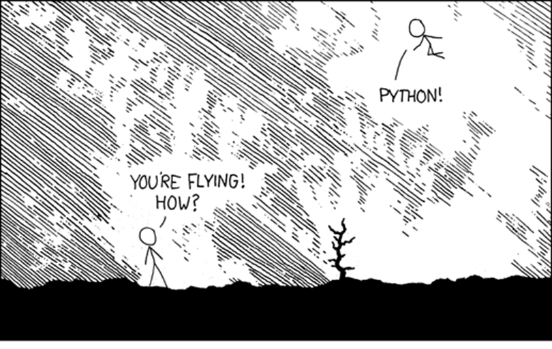
XKCD 353

Slide 15
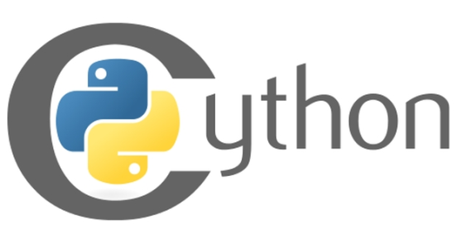
Python is fast enough
Written in C
Easy to wrap more C
Easy to parallelize
Benchmark Game | NumFocus Benchmarks

Slide 16
Python is popular and has a great community

Slide 17
Popularity
Python is 7th most popular tag on StackOverflow
R is 24th most popular tag
MATLAB is 58th most popular tag
stackoverflow.com/tags, Feb 2017

Slide 18
Active community
3rd most active repositories on GitHub after Java (incl. Android) and JavaScript (incl. node.js)
~4.8-fold more than R (12th)
~27-fold more than MATLAB (24th)
As of Feb 2017
See breakdown at githut

Slide 19
Python has a lot of great libraries

Slide 20
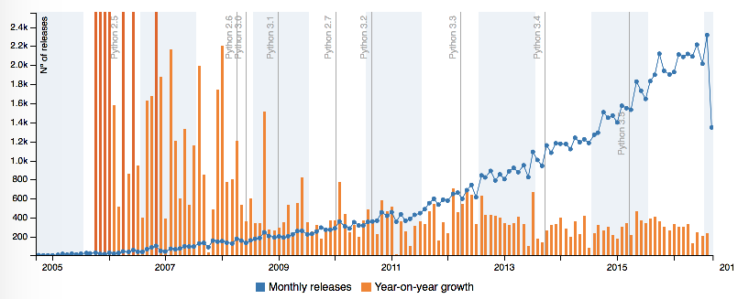
Many new libraries released every month
During 2016 >2,000 new packages released every month.
See more stats at PyGarden/stats.

Slide 21
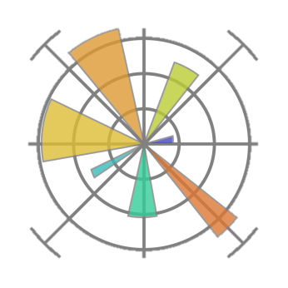
Python can do nearly everything MATLAB and R can do
With libraries like NumPy, SciPy, Matplotlib, IPython/Jupyter,
Scikit-image, Scikit-learn, and more

Slide 22
Differential equations
x = scipy.integrate.odeint(f, w0, t, …)
plot(t, x[:, 0])
plot(t, x[:, 1])

Slide 23
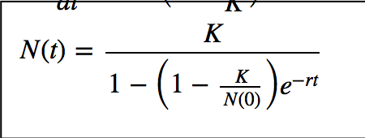
Model fitting
params, cov = scipy.optimize.curve_fit(
f=logistic, xdata=t, ydata=y, p0=(1, 10, 1))
N0=1.512, K=8.462, r=0.758

Slide 24
Optimization
res = scipy.optimize.minimize_scalar(
f, method="bounded", bounds=[8, 16])
fun: -0.23330441717143405
message: 'Solution found.'
nfev: 9
status: 0
success: True
x: 11.706005

Slide 25
Image analysis
segmented = image > threshold
dilated = scipy.ndimage.generic_filter(segmented, max)
labels = skimage.measure.label(dilated)
image
labels

Slide 26
Machine learning
knn = sklearn.neighbors.KNeighborsClassifier()
knn.fit(X_train, y_train)
knn.predict(X_test)
Accuracy: 0.9

Slide 27
Deep learning
with tensorflow.Session() as s:
readout = s.graph.get_tensor_by_name('softmax:0')
predictions = s.run(readout, {’Image': image_data})
pred_id = predictions.argmax()
Label = node_lookup.id_to_string(pred_id)
score = predictions[pred_id]
basketball (score = 0.98201)

Slide 28
Demand & supply of Python programmers is high

Slide 29
(Feb 2, 2017)
Coding Dojo

Slide 30
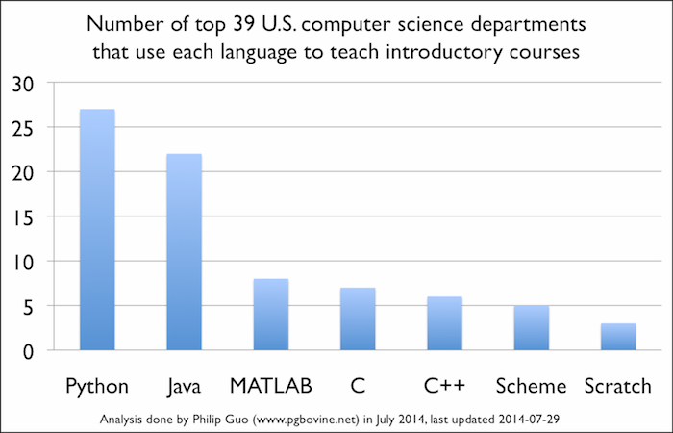
Phillip Gou @ CACM

Slide 31
First language at Israeli universities
TAU: CS & Engineering use Python
Technion: CS use C, some courses in Python
HUJI: CS & Humanities, use Python
BGU: CS use Java, Engineering use C

Slide 32

History of Python
Developed in 1989-91 by Guido van Rossum in the Netherlands
Python 2.0 released Oct 2000 (support ends 2020)
Python 3.0 released Dec 2008
Python 3.6 released Dec 2016
Python 3 is widely used
Guido

Slide 33
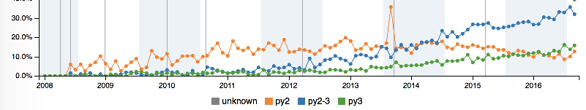
2 vs 3
If you use Python 2.x:
2012 called, they want their print back
Seriously, consider moving to 3.x ASAP
But at least 3.4
See www.python3statement.org
http://pygarden.com/stats

Slide 34
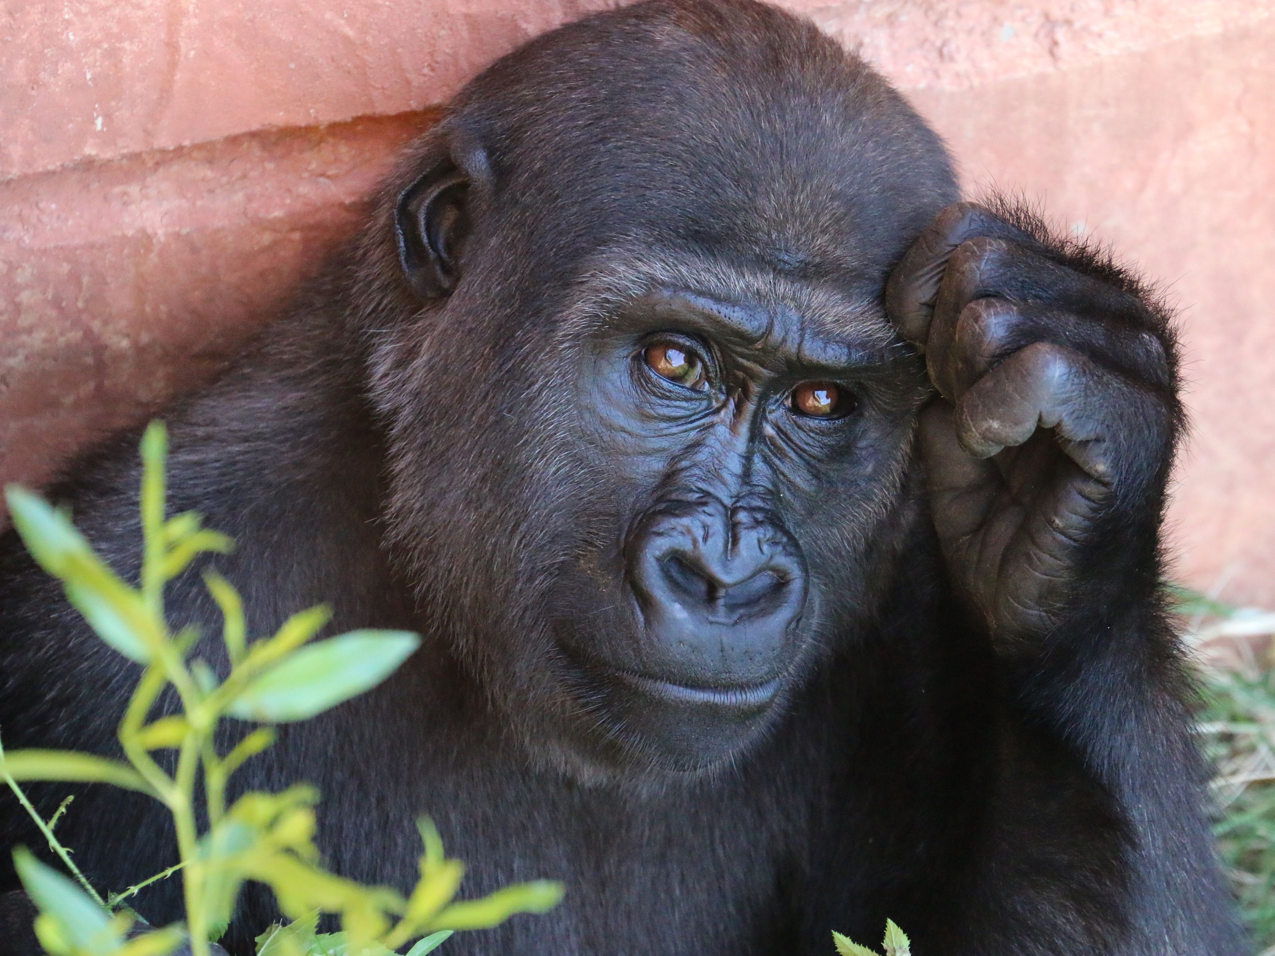
Scientific Python in action: Theoretical Evolution
Photo by Rob Schreckhise

Slide 35
Scientific Python in action: Theoretical Evolution
Formally this field is Population Genetics
Study changes in frequency of gene variants within populations
Focus on two forces:
Natural selection
Random genetic drift
Methods from applied math, statistics, CS, theoretical physics
Population genetics

Slide 36
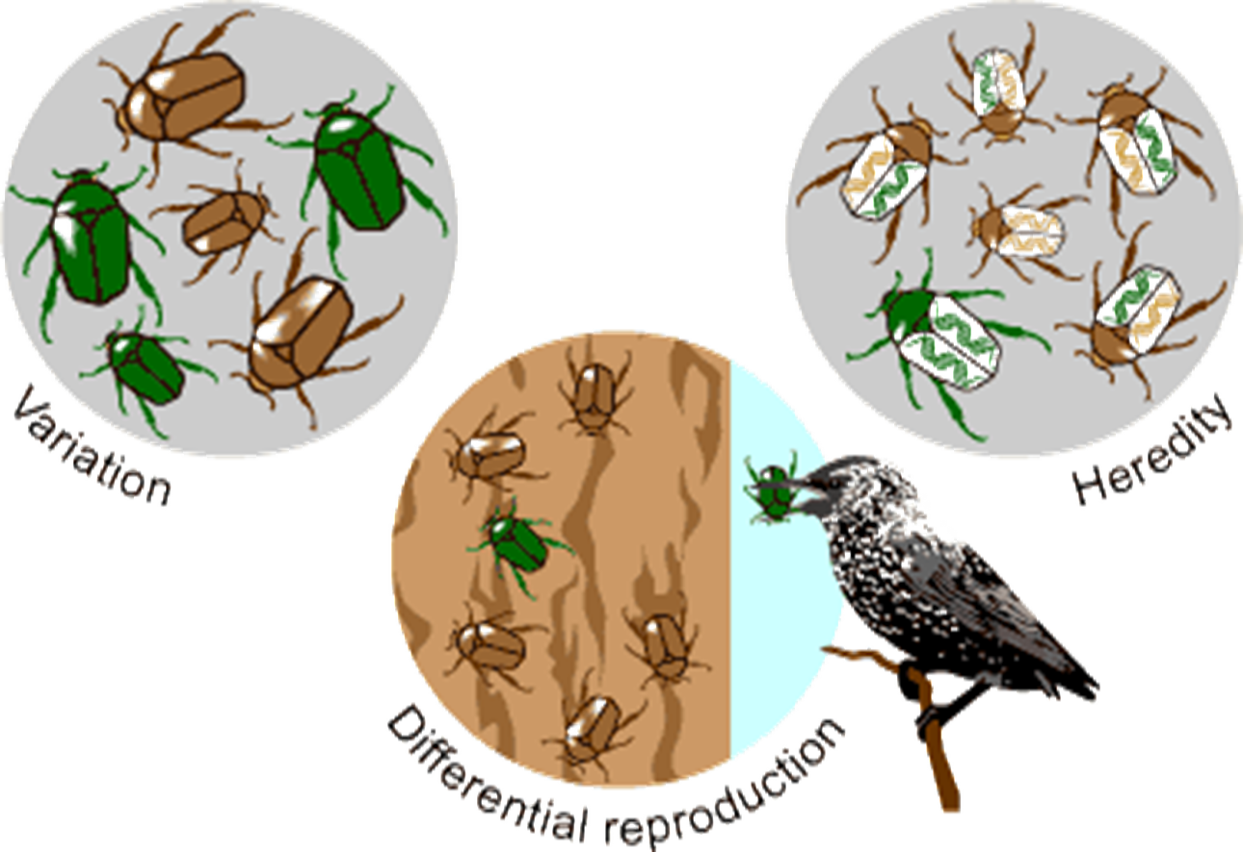
Evolution
University of California Museum of Paleontology Understanding Evolution

Slide 37

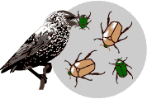


Natural Selection

Slide 38

Random Genetic Drift

Slide 39
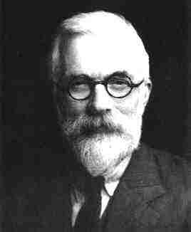
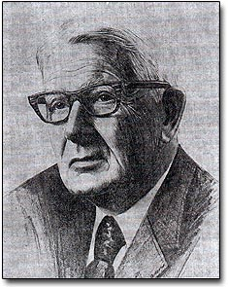
Wright-Fisher Model
Standard model for change in frequency of gene variants
R.A. Fisher
1890-1962
UK & Australia
Sewall Wright
1889-1988
USA

Slide 40
Wright-Fisher Model
Standard model for change in frequency of gene variants
Two gene variants: 0 and 1.
Number of individuals with each variant is n₀ and n₁.
Total population size is N = n₀ + n₁.
Frequency of each variant is p₀=n₀/N and p₁=n₁/N.

Slide 41
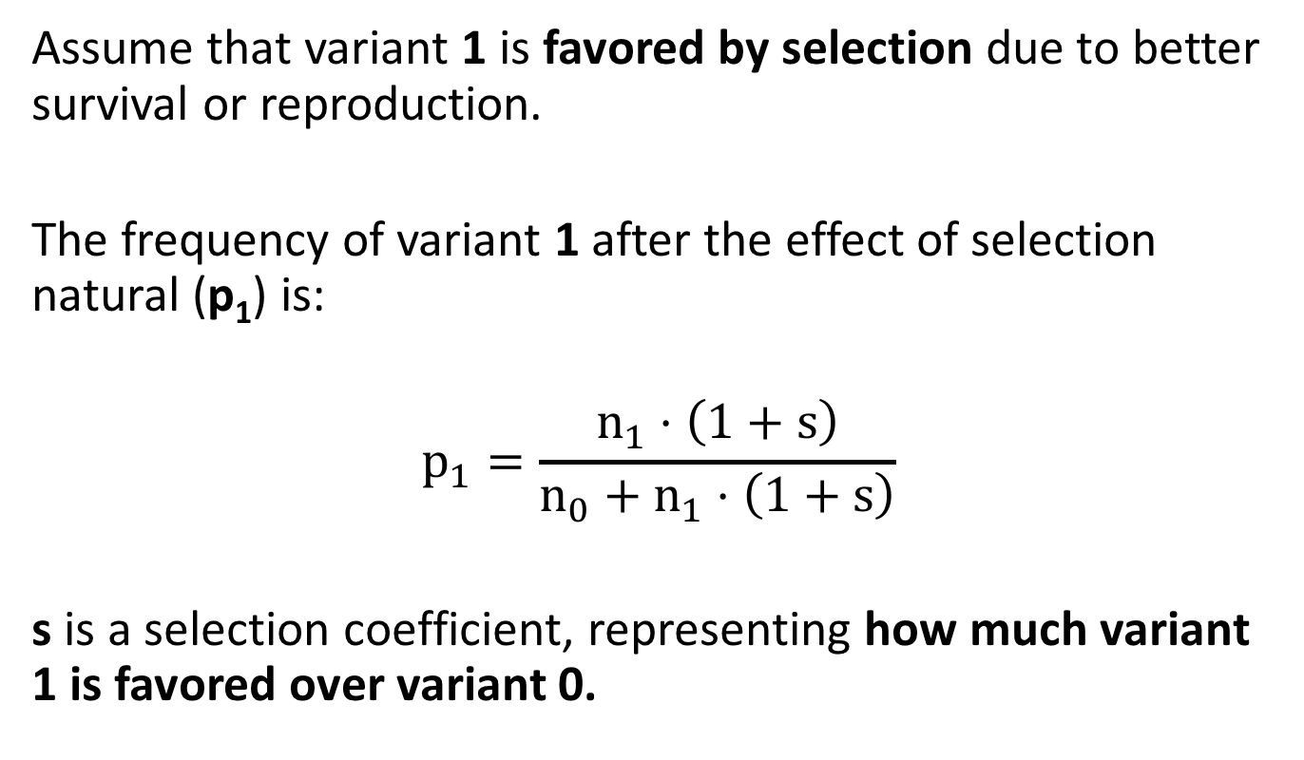
Wright-Fisher Model
Assume that variant 1 is favored by selection due to better survival or reproduction.
The frequency of variant 1 after the effect of selection natural (p₁) is:
$$p_{1}=\frac{n_{1}⋅\left(1+s\right)}{n_{0}+n_{1}⋅\left(1+s\right)}$$
s is a selection coefficient, representing how much variant 1 is favored over variant 0.

Slide 42
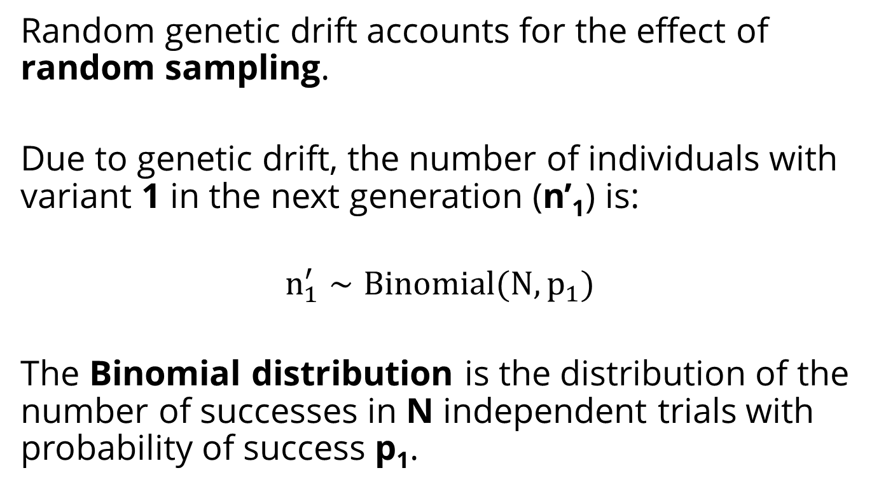
Wright-Fisher Model
Random genetic drift accounts for the effect of random sampling.
Due to genetic drift, the number of individuals with variant 1 in the next generation (n’₁) is:
$$n_{1}^{′}∼Binomial(N, p_{1})$$
The Binomial distribution is the distribution of the number of successes in N independent trials with probability of success p₁.

Slide 43
Fixation Probability
Assume a single copy variant 1 in a population of size N.
What is the probability that variant 1 will take over the population rather than go extinct?

Slide 44
NumPy
The fundamental package for scientific computing with Python:
N-dimensional arrays
Random number generators
Array functions
Broadcasting
Tools for integrating C/C++ and Fortran code
Linear algebra
Fourier transform
numpy.org
Loosing your loops

Slide 45

Into the code
Death to the Stock Photo

Slide 46
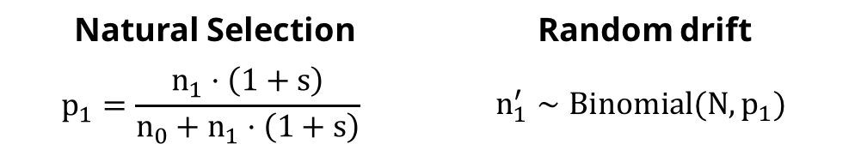
Random drift | Natural Selection
$$n_{1}^{′}∼Binomial(N, p_{1})$$ | $$p_{1}=\frac{n_{1}⋅\left(1+s\right)}{n_{0}+n_{1}⋅\left(1+s\right)}$$
from numpy.random import binomial
n1 = 1
while 0 < n1 < N:
n0 = N - n1
p1 = n1*(1+s) / (n0 + n1*(1+s))
n1 = binomial(N, p1)
fixation = n1 == N
Import a binomial random number generator from NumPy

Slide 47
Random drift | Natural Selection
$$n_{1}^{′}∼Binomial(N, p_{1})$$ | $$p_{1}=\frac{n_{1}⋅\left(1+s\right)}{n_{0}+n_{1}⋅\left(1+s\right)}$$
from numpy.random import binomial
n1 = 1
while 0 < n1 < N:
n0 = N - n1
p1 = n1*(1+s) / (n0 + n1*(1+s))
n1 = binomial(N, p1)
fixation = n1 == N
Start with a single copy of variant 1

Slide 48
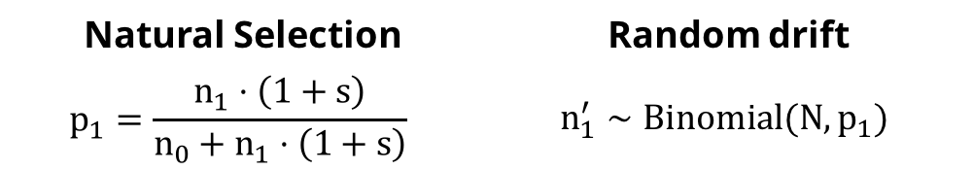
Random drift | Natural Selection
$$n_{1}^{′}∼Binomial(N, p_{1})$$ | $$p_{1}=\frac{n_{1}⋅\left(1+s\right)}{n_{0}+n_{1}⋅\left(1+s\right)}$$
from numpy.random import binomial
n1 = 1
while 0 < n1 < N:
n0 = N - n1
p1 = n1*(1+s) / (n0 + n1*(1+s))
n1 = binomial(N, p1)
fixation = n1 == N
Until number of individuals with variant 1 is 0 or N: extinction or fixation

Slide 49
Random drift | Natural Selection
$$n_{1}^{′}∼Binomial(N, p_{1})$$ | $$p_{1}=\frac{n_{1}⋅\left(1+s\right)}{n_{0}+n_{1}⋅\left(1+s\right)}$$
from numpy.random import binomial
n1 = 1
while 0 < n1 < N:
n0 = N - n1
p1 = n1*(1+s) / (n0 + n1*(1+s))
n1 = binomial(N, p1)
fixation = n1 == N
The frequency of variant 1 after selection is p1

Slide 50
Random drift | Natural Selection
$$n_{1}^{′}∼Binomial(N, p_{1})$$ | $$p_{1}=\frac{n_{1}⋅\left(1+s\right)}{n_{0}+n_{1}⋅\left(1+s\right)}$$
from numpy.random import binomial
n1 = 1
while 0 < n1 < N:
n0 = N - n1
p1 = n1*(1+s) / (n0 + n1*(1+s))
n1 = binomial(N, p1)
fixation = n1 == N
Due to genetic drift, the number of individuals with variant 1 in the next generation is n1

Slide 51
Random drift | Natural Selection
$$n_{1}^{′}∼Binomial(N, p_{1})$$ | $$p_{1}=\frac{n_{1}⋅\left(1+s\right)}{n_{0}+n_{1}⋅\left(1+s\right)}$$
from numpy.random import binomial
n1 = 1
while 0 < n1 < N:
n0 = N - n1
p1 = n1*(1+s) / (n0 + n1*(1+s))
n1 = binomial(N, p1)
fixation = n1 == N
Fixation: n1 equals N
Extinction: n1 equals 0

Slide 52
NumPy vs. Pure Python
NumPy is useful for random number generation:
n1 = binomial(N, p1)
Pure Python version would replace this with:
from random import random
rands = (random() for _ in range(N))
n1 = sum(1
for r in rands
if r < p1)
random is a standard library module

Slide 53
NumPy vs. Pure Python
%timeit simulation(N=1000, s=0.1)
%timeit simulation(N=1000000, s=0.01)
Pure Python version:
100 loops, best of 3: 6.42 ms per loop
1 loop, best of 3: 528 ms per loop
NumPy version:
10000 loops, best of 3: 150 µs per loop x42 faster
1000 loops, best of 3: 313 µs per loop
x1680 faster!

Slide 54
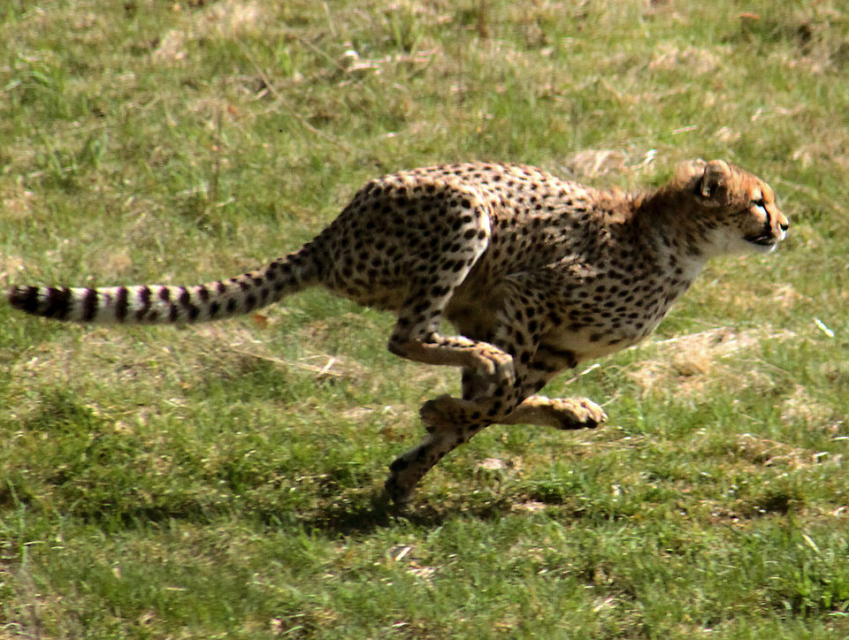
Can we do it
better faster?
Photo by Malene Thyssen

Slide 55
Optimizing compiler
Declare the static type of variables
Makes writing C extensions for Python as easy as Python itself
Foreign function interface for invoking C/C++ routines
http://cython.org

Slide 56
def simulation(np.uint64_t N, np.float64_t s):
cdef np.uint64_t n1 = 1
cdef np.uint64_t n0
cdef np.float64_t p
while 0 < n1 < N:
n0 = N - n1
p1 = n1 * (1 + s) / (n0 + n1 * (1 + s))
n1 = np.random.binomial(N, p1)
return n1 == N

Slide 57
Cython
%timeit simulation(N=1000, s=0.1)
%timeit simulation(N=1000000, s=0.01)
Cython vs. NumPy:
10000 loops, best of 3: 87.8 µs per loop x2 faster
10000 loops, best of 3: 177 µs per loop x1.75 faster

Slide 58

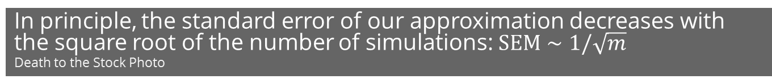
To approximate the fixation probability we need to run many simulations. Thousands.
In principle, the standard error of our approximation decreases with the square root of the number of simulations: $SEM∼1/\sqrt{m}$
Death to the Stock Photo

Slide 59
Multiple simulations: for loop
fixations = [
simulation(N, s)
for _ in range(1000)
]

Slide 60
Multiple simulations: for loop
fixations = [
simulation(N, s)
for _ in range(1000)
]
fixations
[False, True, False, ..., False, False]
sum(fixations) / len(fixations)
0.195

Slide 61
Multiple simulations: for loop
%%timeit
fixations = [
simulation(N, s)
for _ in range(1000)
]
1 loop, best of 3: 8.05 s per loop

Slide 62
Multiple simulations: NumPy
def simulation(N, s, repetitions):
n1 = np.ones(repetitions)
update = np.array([True] * repetitions)
while update.any():
p1 = n1 * (1 + s) / (N + n1 * s)
n1[update] = binomial(N, p1[update])
update = (n1 > 0) & (n1 < N)
return n1 == N
Initialize multiple simulations

Slide 63
Multiple simulations: NumPy
def simulation(N, s, repetitions):
n1 = np.ones(repetitions)
update = np.array([True] * repetitions)
while update.any():
p1 = n1 * (1 + s) / (N + n1 * s)
n1[update] = binomial(N, p1[update])
update = (n1 > 0) & (n1 < N)
return n1 == N
Natural selection:
n1 is an array so operations are element-wise

Slide 64
Multiple simulations: NumPy
def simulation(N, s, repetitions):
n1 = np.ones(repetitions)
update = np.array([True] * repetitions)
while update.any():
p1 = n1 * (1 + s) / (N + n1 * s)
n1[update] = binomial(N, p1[update])
update = (n1 > 0) & (n1 < N)
return n1 == N
Genetic drift:
p1 is an array so binomial(N, p1) draws from multiple distributions

Slide 65
Multiple simulations: NumPy
def simulation(N, s, repetitions):
n1 = np.ones(repetitions)
update = np.array([True] * repetitions)
while update.any():
p1 = n1 * (1 + s) / (N + n1 * s)
n1[update] = binomial(N, p1[update])
update = (n1 > 0) & (n1 < N)
return n1 == N
update follows the simulations that didn’t finish yet

Slide 66
Multiple simulations: NumPy
def simulation(N, s, repetitions):
n1 = np.ones(repetitions)
update = np.array([True] * repetitions)
while update.any():
p1 = n1 * (1 + s) / (N + n1 * s)
n1[update] = binomial(N, p1[update])
update = (n1 > 0) & (n1 < N)
return n1 == N
update follows the simulations that didn’t finish yet

Slide 67
Multiple simulations: NumPy
def simulation(N, s, repetitions):
n1 = np.ones(repetitions)
update = np.array([True] * repetitions)
while update.any():
p1 = n1 * (1 + s) / (N + n1 * s)
n1[update] = binomial(N, p1[update])
update = (n1 > 0) & (n1 < N)
return n1 == N
result is array of Booleans: for each simulation, did variant 1 fix?

Slide 68
Multiple simulations: NumPy
%timeit simulation(N=1000, s=0.1)
10 loops, best of 3: 25.2 ms per loop
x320 faster

Slide 69
Fixation probability as a function of N
Nrange = np.logspace(1, 6, 20, dtype=np.uint64)
N must be an integer for this to evaluate to True:
(n1 > 0) & (n1 < N)

Slide 70
Fixation probability as a function of N
fixations = [
simulation(
N,
s, repetitions
) for N in Nrange
]

Slide 71
Fixation probability as a function of N
fixations = np.array(fixations)
fixations
array([[False, False, ..., False, False],
[False, True, ..., False, False],
, ...,
[False, False, ..., True, False],
[False, False, ..., False, False]],
dtype=bool)

Slide 72
Fixation probability as a function of N
fixations = np.array(fixations)
mean = fixations.mean(axis=1)
sem = fixations.std(
axis=1,
ddof=1
) / np.sqrt(repetitions)

Slide 73
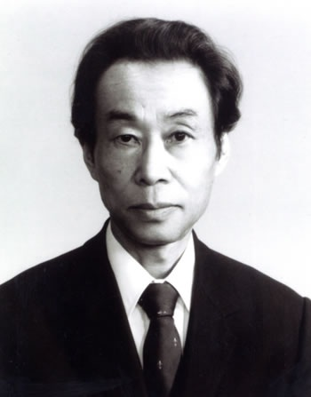
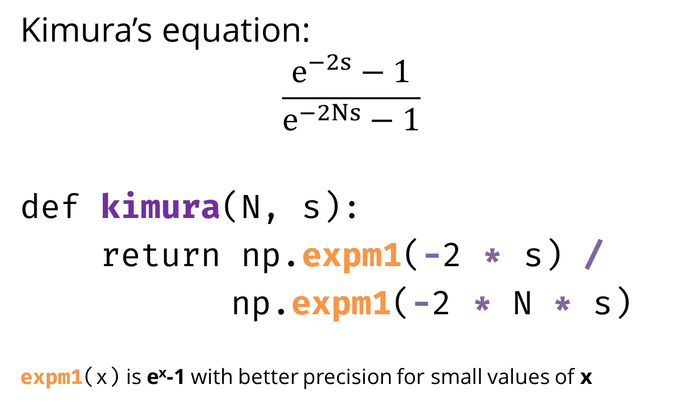
Approximation
Kimura’s equation:
$$\frac{e^{−2s}−1}{e^{−2Ns}−1}$$
def kimura(N, s):
return np.expm1(-2 * s) /
np.expm1(-2 * N * s)
expm1(x) is e^{x}-1 with better precision for small values of x
Motoo Kimura
1924-1994
Japan & USA

Slide 74
kimura works on arrays out-of-the-box
%timeit [kimura(N=N, s=s)
for N in Nrange]
%timeit kimura(N=Nrange, s=s)
1 loop, best of 3: 752 ms per loop
1000 loops, best of 3: 3.91 ms per loop
X200 faster!

Slide 75
Numexpr
Fast evaluation of element-wise array expressions using a vector-based virtual machine
def kimura(N, s):
return numexpr.evaluate(
"expm1(-2 * s) /
expm1(-2 * N * s)“)
%timeit kimura(N=Nrange, s=s)
1000 loops, best of 3: 803 µs per loop x5 faster
https://github.com/pydata/numexpr

Slide 76
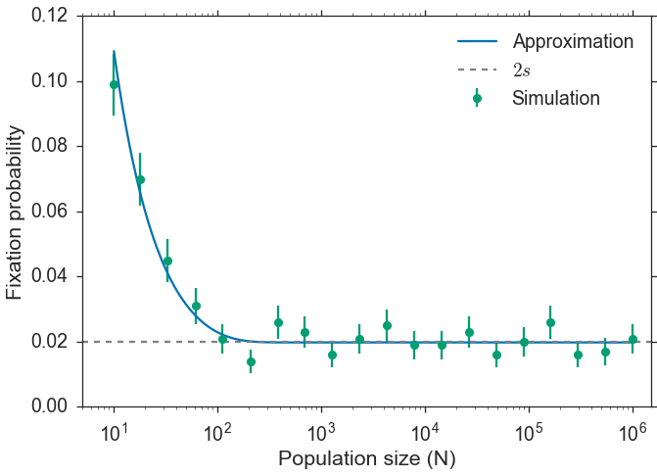
Plotting with matplotlib
http://matplotlib.org

Slide 77
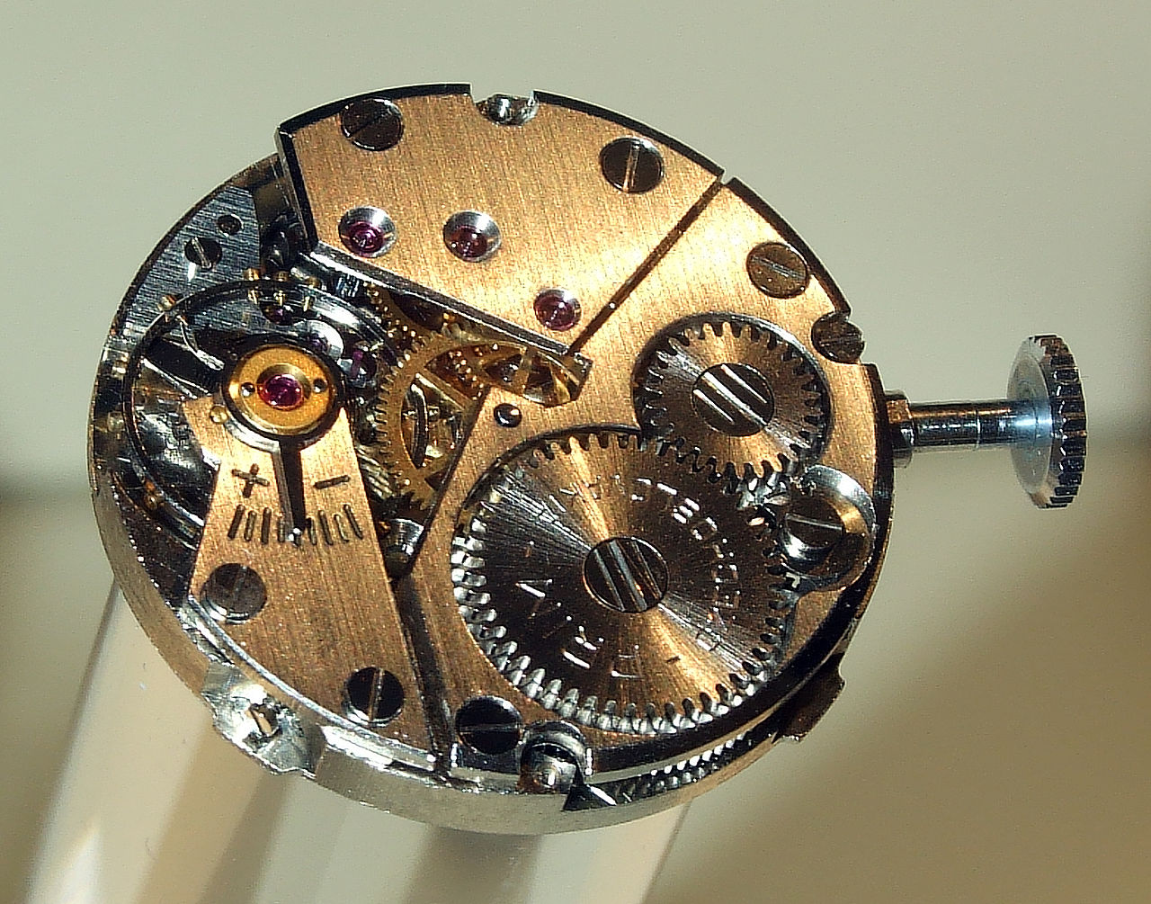
Fixation time
How much time does it take variant 1 to go extinct or to fix?
We want to keep track of time*.
time is measured in number of generations
https://commons.wikimedia.org/wiki/File:Prim_clockwork.jpg

Slide 78
def simulation(N, s, repetitions):
n1 = np.ones(repetitions)
T = np.empty_like(n1)
update = (n1 > 0) & (n1 < N)
t = 0
while update.any():
t += 1
p = n1 * (1 + s) / (N + n1 * s)
n1[update] = binomial(N, p[update])
T[update] = t
update = (n1 > 0) & (n1 < N)
return n1 == N, T
t keeps track of time

Slide 79
def simulation(N, s, repetitions):
n1 = np.ones(repetitions)
T = np.empty_like(n1)
update = (n1 > 0) & (n1 < N)
t = 0
while update.any():
t += 1
p = n1 * (1 + s) / (N + n1 * s)
n1[update] = binomial(N, p[update])
T[update] = t
update = (n1 > 0) & (n1 < N)
return n1 == N, T
T holds time for extinction/fixation

Slide 80
def simulation(N, s, repetitions):
n1 = np.ones(repetitions)
T = np.empty_like(n1)
update = (n1 > 0) & (n1 < N)
t = 0
while update.any():
t += 1
p = n1 * (1 + s) / (N + n1 * s)
n1[update] = binomial(N, p[update])
T[update] = t
update = (n1 > 0) & (n1 < N)
return n1 == N, T
Return both Booleans
and times (T)

Slide 81
Statistical data visualization with Seaborn
Visualization library based on matplotlib and Pandas
High-level interface for attractive statistical graphics
By Michael Waskom, postdoc at NYU
http://seaborn.pydata.org

Slide 82
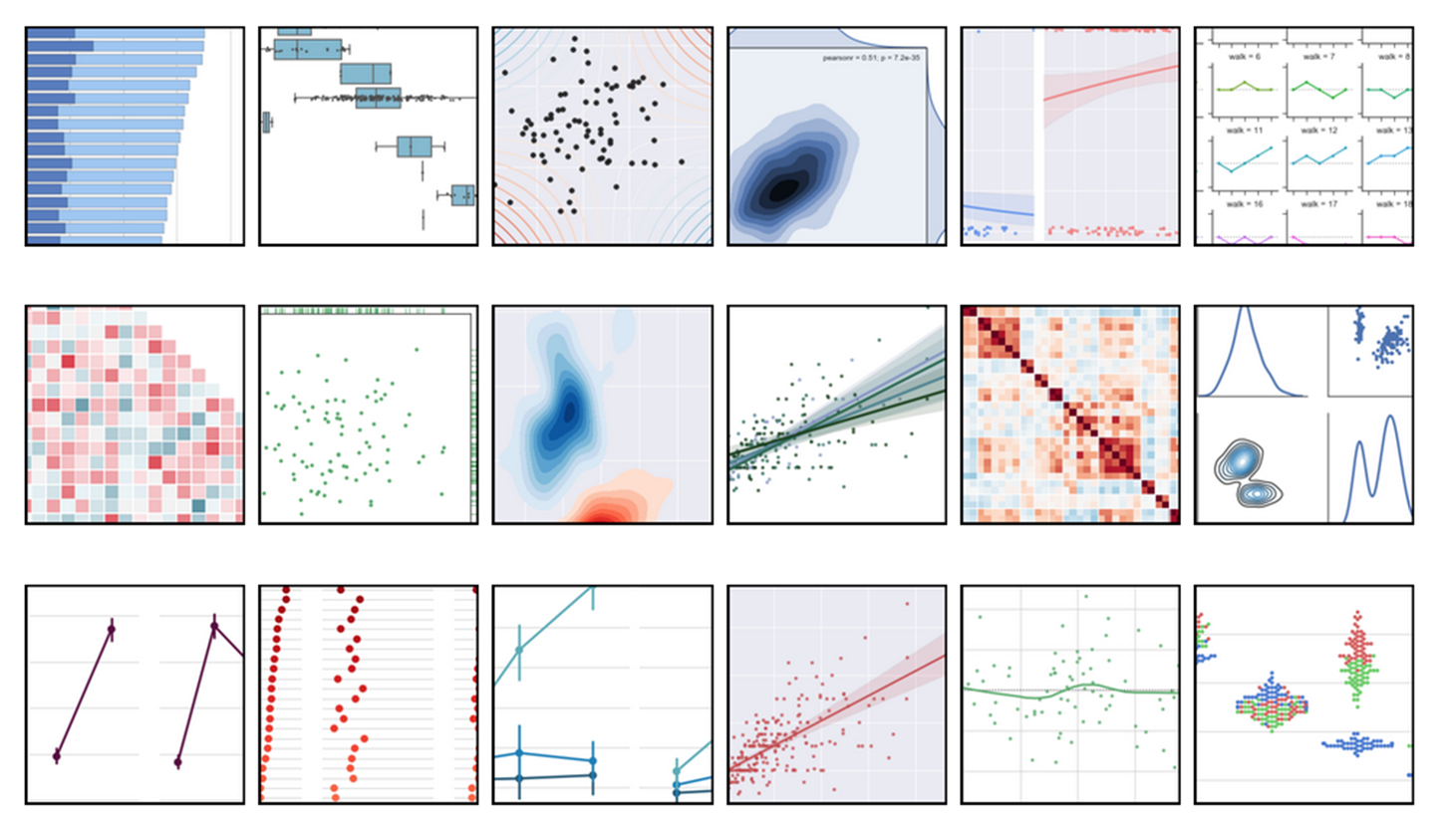
Statistical data visualization with Seaborn

Slide 83
Plot with Seaborn
from seaborn import distplot
fixations, times = simulation(…)
distplot(times[fixations])
distplot(times[~fixations])

Slide 84
Plot with Seaborn
from seaborn import distplot
fixations, times = simulation(…)
distplot(times[fixations])
distplot(times[~fixations])

Slide 85
Plot with Seaborn
from seaborn import distplot
fixations, times = simulation(…)
distplot(times[fixations])
distplot(times[~fixations])

Slide 86
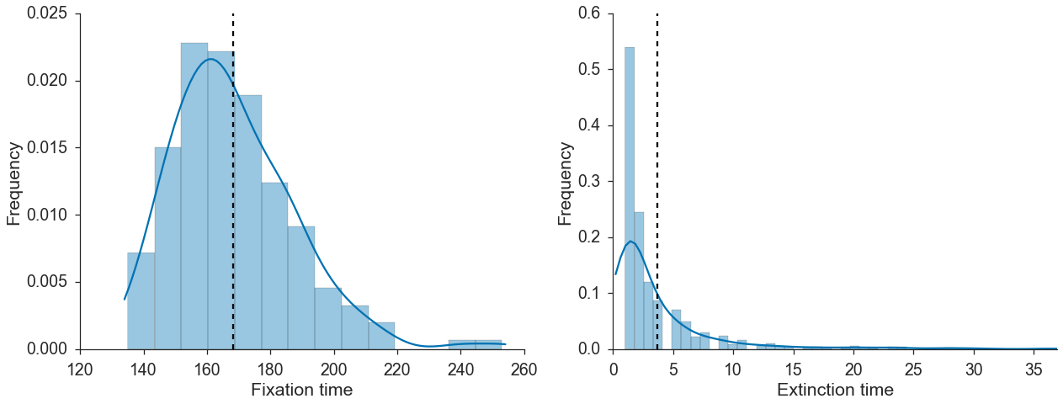
Plot with Seaborn
fixations, times = simulation(…)
distplot(times[fixations])
distplot(times[~fixations])

Slide 87
Diffusion equation approximation
Motoo Kimura
1924-1994
Japan & USA

Slide 88
Diffusion equation approximation
Requires
integration…
Motoo Kimura
1924-1994
Japan & USA

Slide 89

from functools import partial
from scipy.integrate import quad
def integral(f, N, s, a, b):
f = partial(f, N, s)
return quad(f, a, b)[0]
integral will calculate $\int_{a}^{b}{f\left(N,s,x\right)dx}$

Slide 90
from functools import partial
from scipy.integrate import quad
def integral(f, N, s, a, b):
f = partial(f, N, s)
return quad(f, a, b)[0]
partial freezes N and s
in f(N, s, x) to create f(x)

Slide 91
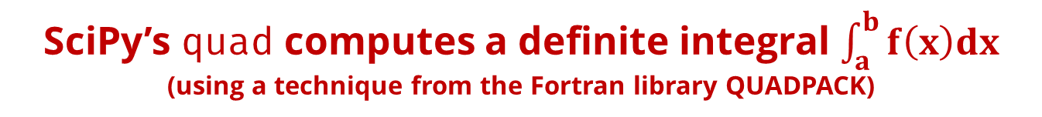
from functools import partial
from scipy.integrate import quad
def integral(f, N, s, a, b):
f = partial(f, N, s)
return quad(f, a, b)[0]
SciPy’s quad computes a definite integral $\int_{a}^{b}{f\left(x\right)dx}$
(using a technique from the Fortran library QUADPACK)

Slide 92
def I1(N, s, x):
…
def I2(N, s, x):
…
I1 and I2 are defined according to the equations

Slide 93
@np.vectorize
def T_kimura(N, s):
x = 1.0 / N
J1 = -1.0 / (s * expm1(-2 * N * s)) *
integral(I1, N, s, x, 1)
J2 = -1.0 / (s * expm1(-2 * N *s)) *
integral(I2, N, s, 0, x)
u = expm1(-2 * N * s * x) /
expm1(-2 * N * s)
return J1 + ((1 - u) / u) * J2
T_kimura is the fixation time given a single copy of variant 1: frequency x=1/N

Slide 94
@np.vectorize
def T_kimura(N, s):
x = 1.0 / N
J1 = -1.0 / (s * expm1(-2 * N * s)) *
integral(I1, N, s, x, 1)
J2 = -1.0 / (s * expm1(-2 * N *s)) *
integral(I2, N, s, 0, x)
u = expm1(-2 * N * s * x) /
expm1(-2 * N * s)
return J1 + ((1 - u) / u) * J2
J1 and J2 are calculated using integrals of I1 and I2

Slide 95
@np.vectorize
def T_kimura(N, s):
x = 1.0 / N
J1 = -1.0 / (s * expm1(-2 * N * s)) *
integral(I1, N, s, x, 1)
J2 = -1.0 / (s * expm1(-2 * N *s)) *
integral(I2, N, s, 0, x)
u = expm1(-2 * N * s * x) /
expm1(-2 * N * s)
return J1 + ((1 - u) / u) * J2
T_{fix} is the return value

Slide 96
@np.vectorize
def T_kimura(N, s):
x = 1.0 / N
J1 = -1.0 / (s * expm1(-2 * N * s)) *
integral(I1, N, s, x, 1)
J2 = -1.0 / (s * expm1(-2 * N *s)) *
integral(I2, N, s, 0, x)
u = expm1(-2 * N * s * x) /
expm1(-2 * N * s)
return J1 + ((1 - u) / u) * J2
np.vectorize creates a function that takes a sequence and returns an array - x2 faster

Slide 97
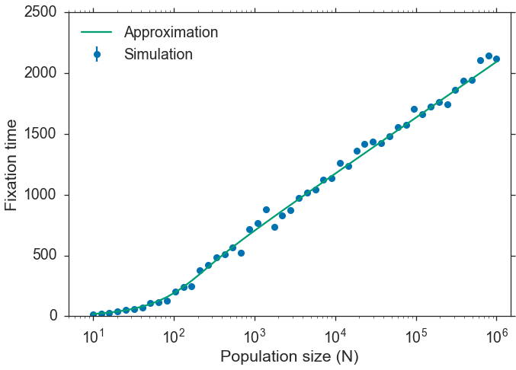

Slide 98
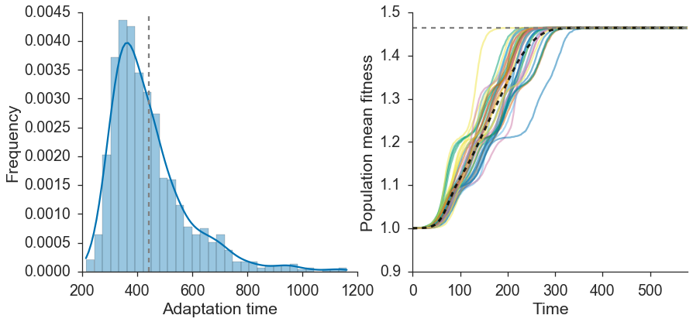
Dig Deeper Online Jupyter notebook: github.com/yoavram/PyConIL2016
Multi-type simulation:
Includes L variants, with mutation.
Follow n₀, n₁, …, n_{L} until n_{L}=N.

Slide 99
Dig Deeper Online Jupyter notebook: github.com/yoavram/PyConIL2016
Numba: JIT compiler, array-oriented and math-heavy Python syntax to machine code
IPyParallel: IPython’s sophisticated and powerful architecture for parallel and distributed computing.
IPyWidgets: Interactive HTML Widgets for Jupyter notebooks and the IPython kernel

Slide 100







Thank You!
Presentation & Jupyter notebook : git.io/14032017
yoav@yoavram.com
@yoavram
github.com/yoavram
www.yoavram.com
python.yoavram.com
Death to the Stock Photo

